Slide 1
Pseudo-Random Number Generation How it Works, What the CIA Knows, and What Options Exist in Perl?
February 13th, 2014 – Houston Perl Mongers
Robert Stone
HostGator.com

Slide 2
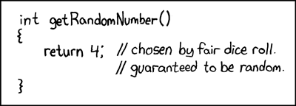
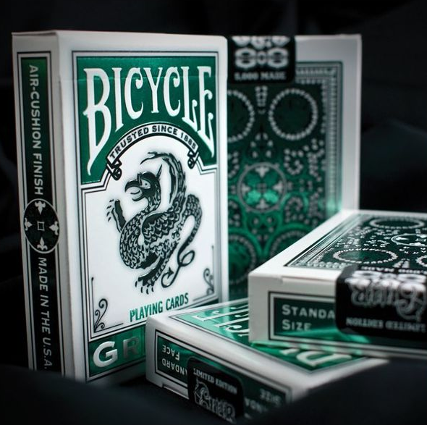

Overview
What are Random Number Generators?
Pseudo vs Truly Random
Terms
Sample Types
Perl’s Built In Random Number Generator
Configuration
drand48
What the CIA Knows
Elliptic Curve Cryptography
Dual_EC_DRBG Implementation
Snowden, RSA Security and OpenSSL
What Options Exist in Perl?
Best Practices
Modules
xkcd

Slide 3

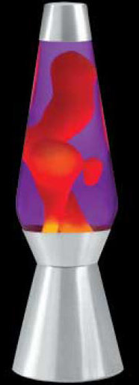




Background – Pseudo vs Truly Random
Truly Random vs Pseudorandom
Sources of True Randomness
Deterministic Random Bit Generator
Why bother with Pseudo Randomness at all?
Speed
Nonblocking
Cost
Reproducibility
Breaking Bad
Notes:
True Randomness comes from the environment (Atmospheric noise, thermal noise, other electromagnetic and quantum phenomena).

Slide 4
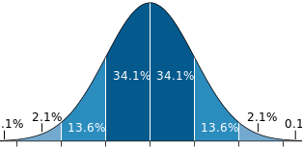
Background – PNRG Terms
Pseudorandom Number Generator
Algorithm
State
Seed
Cycle Length
Distribution
0.169728
0.766490
0.800094
0.821208
0.705562
0.940474
0.809702
0.097294
0.084236
…
Algorithm
Seed
State
Random Numbers
Wikipedia

Slide 5
Background – Sample PNRG Types
Cryptographically Secure PRNG
Next Bit Test
State Compromise Extension
Linear Congruential Generators
Linear Equation
Examples
drand48
Linear Feedback Shift Register
Shift Register
Examples
Mersenne Twister
X_{n+1} = (aX_{n} + c) mod m
m = modulus
a = multiplier
c = increment
X₀ = seed
Wikipedia
Notes:
Next Bit Test - given the first k bits of a random sequence, there is no polynomial-time algorithm that can predict the (k+1)th bit with probability of success better than 50%
State Compromise Extension - In the event that part or all of its state has been revealed (or guessed correctly), it should be impossible to reconstruct the stream of random numbers prior to the revelation

Slide 6
Perl’s Built In - Configuration
Perl will attempt to detect the best options
randfunc
drand48
random
rand
seedfunc
srand48
srandom
srand
randbits
Bits produced by PNRGs
drand48 – 48
random – 31
rand – 31
$ echo4 "Looking for a random number function..."
$ OS
$ WS "#if defined(__DECC) || defined(__DECCXX)"
$ WS "#include <stdlib.h>"
$ WS "#endif"
$ WS "#include <stdio.h>"
$ WS "int main()"
$ WS "{"
$ WS "srand48(12L);"
$ WS "exit(0);"
$ WS "}"
$ CS
$ GOSUB link_ok
$ IF compile_status .EQ. good_compile .AND. link_status .EQ. good_link
$ THEN
$ drand01 = "drand48()"
$ randbits = "48"
$ randfunc = "drand48"
$ randseedtype = "long int"
$ seedfunc = "srand48"
$ echo4 "Good, found drand48()."
$ d_drand48proto = "define“
$ ELSE
$ d_drand48proto = "undef"
$ drand01="random()"
$ randbits = "31"
$ randfunc = "random"
$ randseedtype = "unsigned"
$ seedfunc = "srandom"
$ OS
$ WS "#if defined(__DECC) || defined(__DECCXX)"
$ WS "#include <stdlib.h>"
$ WS "#endif"
$ WS "#include <stdio.h>"
$ WS "int main()"
$ WS "{"
$ WS "srandom(12);"
$ WS "exit(0);"
$ WS "}"
$ CS
$ GOSUB link_ok
$ IF compile_status .EQ. good_compile .AND. link_status .EQ. good_link
$ THEN
$ echo4 "OK, found random()."
$ ELSE
$ drand01= "(((float)rand())*MY_INV_RAND_MAX)"
$ randfunc = "rand"
$ randseedtype = "unsigned"
$ seedfunc = "srand"
$ echo4 "Yick, looks like I have to use rand()."
$ ENDIF
$ ENDIF

Slide 7
Perl’s Built In – drand48
Linear Congruential Generator
Implemented in glibc
Generates Uniformly Distributed Pseudo Random Numbers
[ 0, 1 )
Declared Obsolete by SVID 3
System V Interface Definition
AT&T UNIX System V
Published in 1989
X_{n+1} = (aX_{n} + c) mod m
m = modulus = 2⁴⁸
a = multiplier = 25214903917
c = increment = 11
X₀ = seed = 13070
((25214903917 * 13070) + 11) mod 2⁴⁸ = 48083817484545 => 0.170828
((25214903917 * 48083817484545) + 11) mod 2⁴⁸ = 211078642492280 => 0.749902
((25214903917 * 211078642492280) + 11) mod 2⁴⁸ = 27126209522211 => 0.096372
((25214903917 * 27126209522211) + 11) mod 2⁴⁸ = 245014179504882 => 0.870465
((25214903917 * 245014179504882) + 11) mod 2⁴⁸ = 162496491130133 => 0.577304

Slide 8
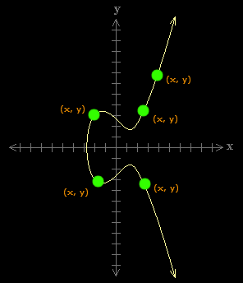
CIA – Dual_EC_DRBG – Elliptic Curves
y² = x³ - 3x + 4 (mod 17)
Given:
P = (16, 2)
Q = (5, 13)
Find k such that P = kQ
Dual_EC_DRBG
Dual Elliptic Curve Deterministic Random Bit Generator
Elliptic Curve
y² = x³ - 3x + b (mod p)
Strength comes from the intractability of the Elliptic Curve Discrete Logarithm Problem
Slope = (2y) / (3x² + 9)
2Q_{x} = (3 *(5²) + 9) = 84 mod 17 = 16
2Q_{y} = (2 * 13) = 26 mod 17 = 9
2Q = (16, 9)
3Q = (12, 1)
4Q = (16, 2)
k = 4

Slide 9
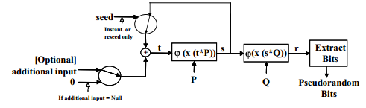
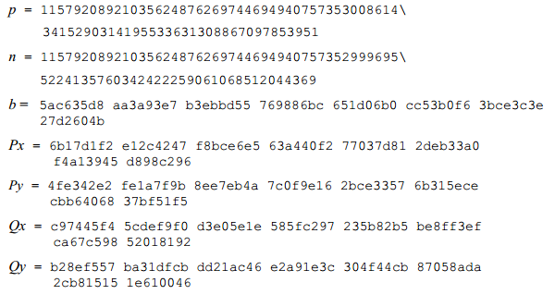
CIA – Dual_EC_DRBG - Implementation
x(foo) = X coordinate of point
ϕ(foo) = Map Integer to Bits
s₁ = x(t₀ * P)
r₁ = x(s₁ * Q)
o₁ = LSBytes30(r₁)
y² = x³ - 3x + b (mod p)
s₂ = x(s₁ * P)
r₂ = x(s₂ * Q)
o₂ = LSBytes30(r₂)
A_{x} = x(s₁ * Q)
kA_{x} = x(s₁ * kQ)
P = kQ
kA_{x} = x(s₁ * P)
s₂ = kA_{x}

Slide 10

CIA – Dual_EC_DRBG - Backdoor
Does anyone know what k is?
Dan Schumow and Niels Ferguson
“On the Possibility of a Back Door in the NIST SP800-90 Dual EC Prng” in August 2007
Edward Snowden
September 5th, 2013 project Bullrun Leaked
Leaked Documents and NY Times Saying YES!
The N.S.A. wrote the standard and aggressively pushed it on the international group, privately calling the effort “a challenge in finesse.”
“Eventually, N.S.A. became the sole editor,” the memo says.
SSL
RSA BSAFE
$10 Million to Make Default
OpenSSL
Never actually worked due to a one line bug in fips_drbg_ec.c
Wikipedia
Notes:
One of the purposes of Bullrun is described as being "to covertly introduce weaknesses into the encryption standards followed by hardware and software developers around the world."

Slide 11
Perl – Best Practices
Know Your Purpose and Your Goals
Do I really need a CSPRNG?
What is at risk?
Know Your Configuration
DON’T SEED SRAND WITH TIME!
Notes:
One of the purposes of Bullrun is described as being "to covertly introduce weaknesses into the encryption standards followed by hardware and software developers around the world."

Slide 12
Perl – Best Practices - srand
01 Feb 2014 23:27:49 GMT
./generate 1391297269 10
0.056156
0.415556
0.568100
0.911399
0.019152
0.365133
0.062495
0.670967
0.222662
0.594826
./predict_given_input 0 0.911399 0.019152 0.365133 \
0.062495 0.670967
------ SNIP -----------
Thread Number: 1 is Attempting Seed: 1391000000
Position in sequence found!
Using Seed: 1391297269
The surrounding sequence is...
0.056156
0.415556
0.568100
*** 0.911399
*** 0.019152
*** 0.365133
*** 0.062495
*** 0.670967
0.222662
0.594826
0.880585
0.445359
0.863512
real 2869m3.584s
user 54178m25.238s
sys 37611m18.834s
Or 1.99 days :D
Notes:
One of the purposes of Bullrun is described as being "to covertly introduce weaknesses into the encryption standards followed by hardware and software developers around the world."

Slide 13
Perl – Best Practices - GoMommy
GoMommy
You are responsible so your reboot your servers weekly for patches!
You give people impossible to remember auto incrementing ids!
You generate a new account’s password for them so you know it’s secure!
Attacker Signs Up
Panica Datrick
Get’s User ID 1337
Get’s Password “ek7U^4rbB”
7 * 24 * 60 * 60 = 2592000 seconds (seeds)
01 / 28 / 14 @ 11:20:11pm UTC
perl predict_given_password.pl 1390951211 \
"ek7U^4rbB"
Found Matching Password 'ek7U^4rbB'
Seed: 1391531211
The next 5 passwords are...
F6(tldd1A
oDo4\i8Vy
6Ugu2hnW|
Jkd)69lyV
iK;c3I2kl
real 38m34.635s
user 260m25.400s
sys 0m28.849s
Notes:
One of the purposes of Bullrun is described as being "to covertly introduce weaknesses into the encryption standards followed by hardware and software developers around the world."

Slide 14
Perl – Best Practices
Know Your Purpose and Your Goals
Do I really need a CSPRNG?
What is at risk?
Know Your Configuration
DON’T SEED SRAND WITH TIME!
Don’t call srand multiple times.
Know Existing Modules
Notes:
One of the purposes of Bullrun is described as being "to covertly introduce weaknesses into the encryption standards followed by hardware and software developers around the world."

Slide 15
Perl – Modules
Module | Description | Notes
Math::TrulyRandom | Uses ALARM interrupt time | Broken, last updated in 1996 Proposed PP Implementation Exists
Crypt::Random::TESHA2 | Updated Version of Above
Crypt::Random | Interface to RNG | Dependency on Math::Pari which has 64 bit and portability issues
Data::Entropy | Specify Entropy Source | Useful in specialized cases
Math::Random::Secure | Seed from /dev/urandom ISAAC Algorithm (Indirection, Shift, Accumulate, Add, and Count) | Very Fast PRNG is Pluggable and preserves interface
Notes:
One of the purposes of Bullrun is described as being "to covertly introduce weaknesses into the encryption standards followed by hardware and software developers around the world."

Slide 16
Questions ?
Learn More!
Numberphile (these guys rock!)
http://youtu.be/ulg_AHBOIQU
Bruce Schneier
https://www.schneier.com/blog/archives/2007/11/the_strange_sto.html
NIST 800-90A
http://csrc.nist.gov/publications/nistpubs/800-90A/SP800-90A.pdf
Notes:
One of the purposes of Bullrun is described as being "to covertly introduce weaknesses into the encryption standards followed by hardware and software developers around the world."

